Slide 1

化学工学会関東支部横浜大会
分類 : 6-f 情報処理技術
2019/8/8
数値シミュレーションレーションによる
粉末金型充填における吸引効果の影響
○吉田昂生¹, 森勇稀¹,高畑和弥¹ 酒井幹夫^{2*}
1. 東京大学大学院工学系研究科原子力国際専攻
2. 東京大学大学院工学系研究科レジリエンス工学研究センター

Slide 2
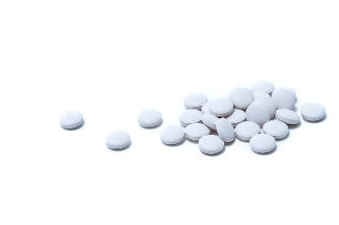
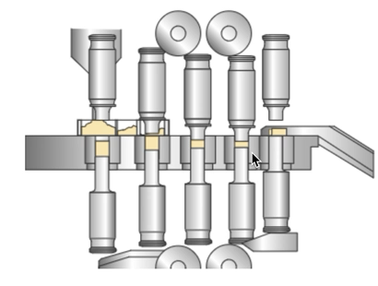
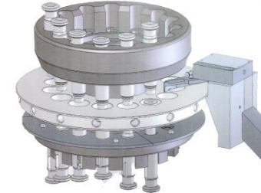
研究背景
・粉末金型充填
錠剤の生産プロセスの一部。充填の後に圧縮・排出を経て錠剤は生産されている。
粉末は充填中に空気抵抗を受けるため、充填には時間がかかりプロセス全体のネックになっている。
Tablet
(www.pakutaso.com)
吸引効果の図
Punchの降下アニメーション？
Rotary Tablet Press Machine
(Copyright © 2003 HATA TEKKOSHO CO.,LTD. All rights reserved.)
・吸引効果
粉末の下に設置した杵を降下させることにより粉末が金型内に引き込まれる効果。
充填速度の改善効果があるとされている。

Slide 3
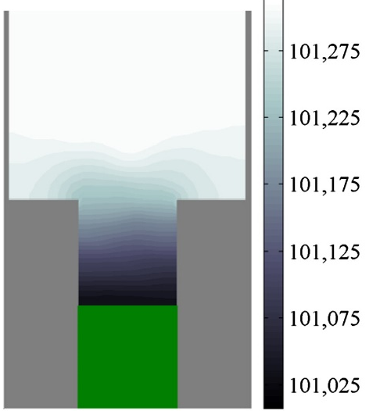
先行研究・本研究の目的
✔ 吸引効果で充填速度が改善できる
実験において、下杵の降下による吸引効果が充填速度を改善できることが確認された。その中で下杵の降下速度が重要なパラメータであることが明らかとなった。^{[1]}
✔ 下杵の降下により低圧が生じる
数値シミュレーションによって、低圧が～！！！！！！！！
速度大きいほうが良さげ！！！！
Air Pressure ^{[1]}
✗ 下杵の降下速度と充填効率の関係性が明らかではない
詳細な様子が見れていない！！！！
目的、数値シミュレーションにより吸引効果が
[1] S. Jackson, I.C. Sinka, A.C.F. Cocks, 2006 [2] C-Y. Wu, Y. Guo 2012
Notes:
It could be assumed that air pressure gradient accelerated the influx of the powder and shortened the filling time ^{[1]} .
But how pressure gradient affected the powder movement has not been clarified so far.

Slide 4
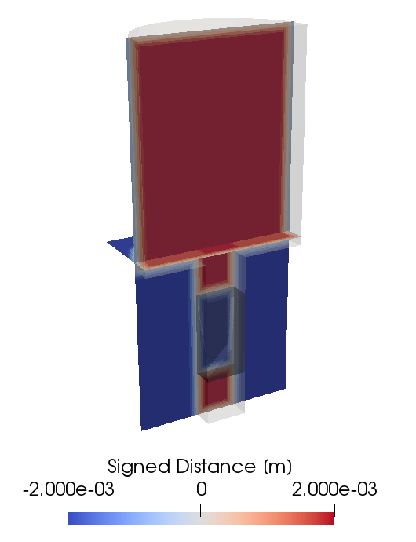
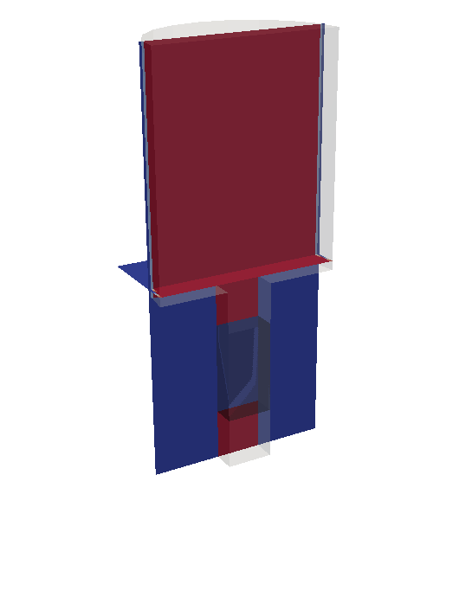
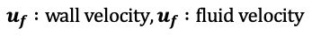
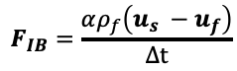
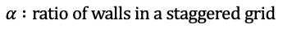
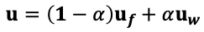
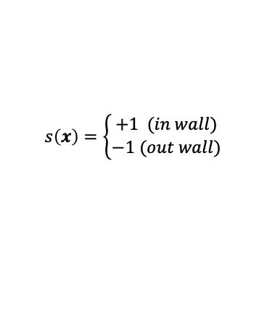
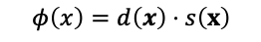
Numerical Method
・Modeling of solid phase and gas phase
In this study, for modeling solid-gas phase interaction DEM-CFD method^{[1]} (Discrete Element Method - Computational Fluid Dynamics) was used. (Particles are modeled by DEM, Air is modeled by CFD)
・Boundary Conditions
In this study, we used Signed Distance Function^{[2]} and Immersed Boundary Method^{[3]} combinedly to calculate moving boundary in gas-solid flow. Only with simple algorithms, this combination enable to calculate interaction with wall in arbitrary shape. This combination of boundary conditions had verified.^{[4][5]}
Solid Phase : SDF (Signed Distance Function)
Gas Phase
$$φ\left(x\right)=d\left(x\right)⋅s\left(x\right)$$
$$s\left(x\right)=\left\{\begin{aligned}+1 (in wall) \\ −1 (out wall)\end{aligned}\right.$$
+
Gas Phase : IBM (Immersed Boundary Method)
$$u=\left(1−α\right)u_{f}+αu_{w}$$
$$F_{IB}=\frac{αρ_{f}\left(u_{s} −u_{f}\right)}{Δt}$$
Wall Region
$$α :ratio of walls in a staggered grid$$
$$u_{f} :wall velocity, u_{f} :fluid velocity$$
SDF Field
IBM Field
[1] Y. Tsuji et al., Powder Tec. (1993).
[2] Y. Shigeto and M. Sakai, Chem. Eng. J. (2013).
[3] C.S. Peskin, J. Comput. Phys. (1972).
[4] Y. Mori et al., Powder Tec. (2019).
[5] H. Yao et al., J. Taiwan Inst. Chem. Eng. J. (2018).
Notes:
5分
Signed Distance Function
Boundary is defined by the scalar field of the distance from wall. With this scalar field, it is easy to calculate the interaction between a particle and a wall.
ImmersedBoundary Method
The interaction between the gas phase and a wall is calculated only by ratio of the wall in a staggered grid. The ratio is obtained easily by Signed Distance Function.
This combination of boundary conditions enables it easy to calculate interaction with wall in arbitrary wall shape, only with very simple algorithms.

Slide 5
How Does the Suction Effect Influences the Powder?

Slide 6
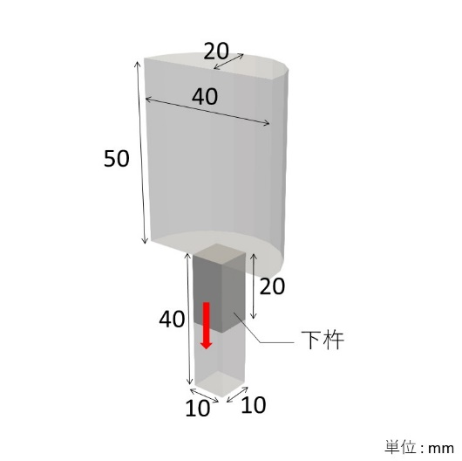
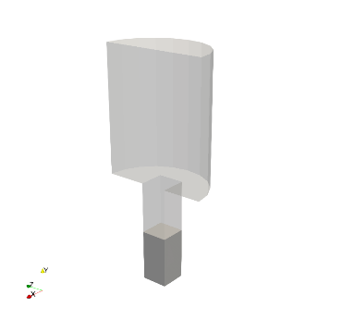
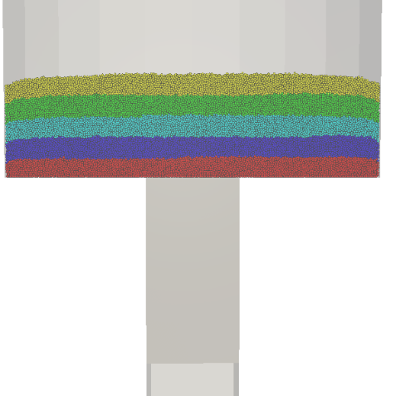
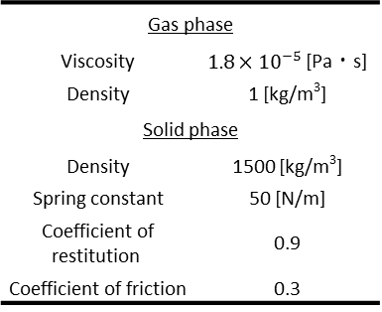
Simulation Conditions
To understand the influence of suction effect, compare the suction filling with the gravity filling.
Physical Properties
 | Case 1-1 | Case 1-2
Filling Type | Suction Filling* | Gravity Filling
Gas phase
Viscosity | $1.8×{10}^{−5}$ [Pa・s]
Density | 1 [kg/m³]
Solid phase
Density | 1500 [kg/m³]
Spring constant | 50 [N/m]
Coefficient of restitution | 0.9
Coefficient of friction | 0.3
* Punch Lower Velocity = 300 [mm/s]
Calculation Conditions
Diameter of particles | 250 [μm]
Number of particles | 500,000
System | Mono-dispersed
Grid size | 0.5 [mm]
Calculation time | 0.24 [s]
Punch
Unit : mm
Schematic Geometry
Initial Position of Particles

Slide 7
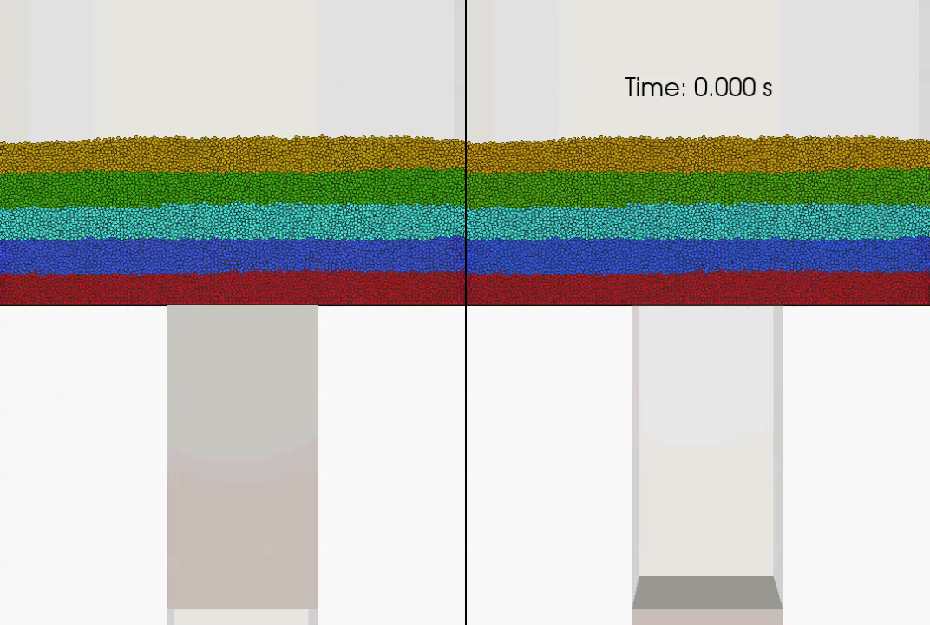
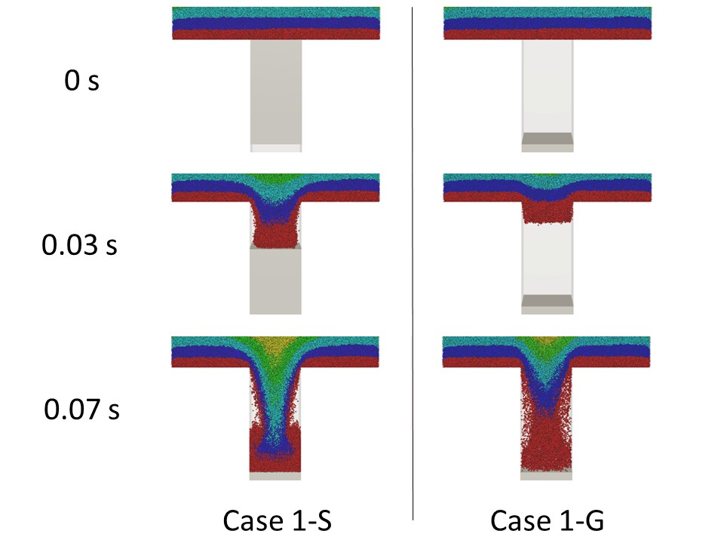
Results & Discussion (Effect of punch movement)
Case 1-1
Suction Filling
Case 1-2
Gravity Filling
Case 1-1
Suction Filling
Case 1-2
Gravity Filling
Suction effect accelerated the flux of powder flow

Slide 8
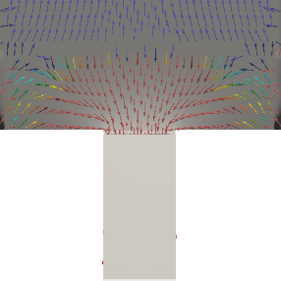
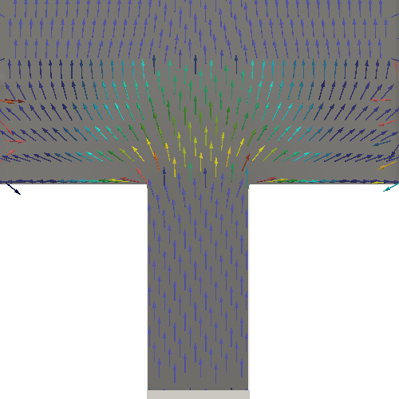
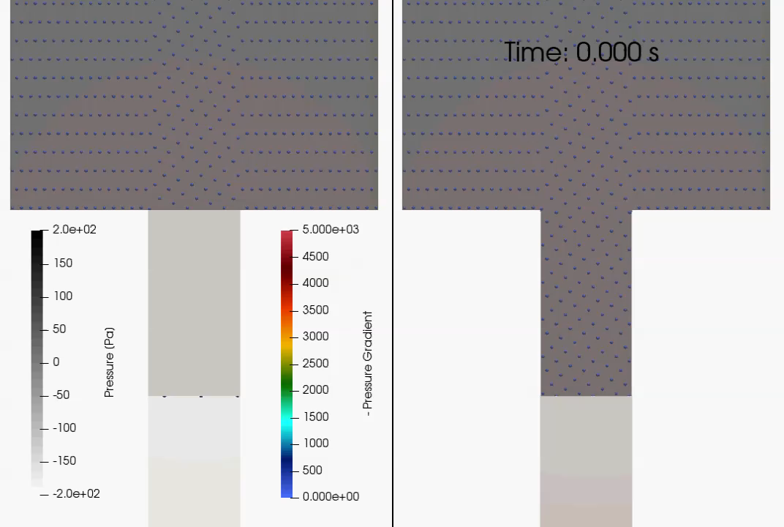
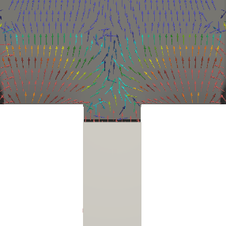
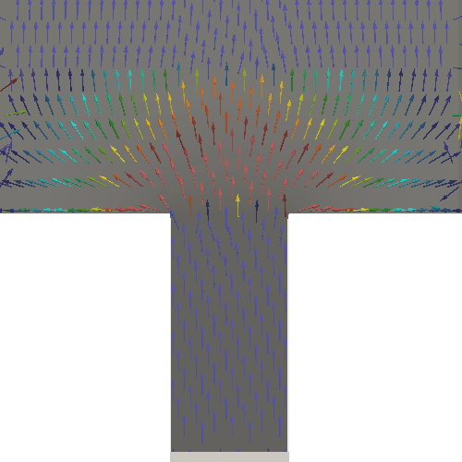
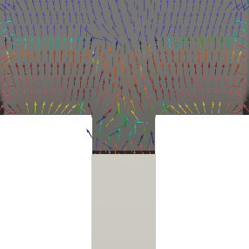
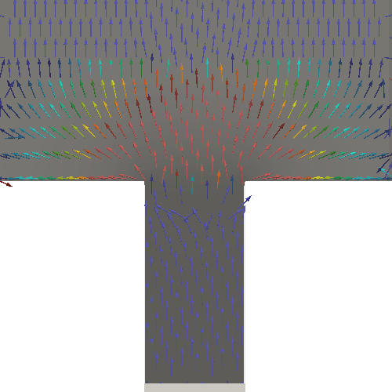
Results & Discussion (Air Pressure Gradient)
0.002s
0.010s
0.020s
Case 1-1
Suction Filling
Case 1-2
Gravity Filling
Case 1-1
Suction Filling
Case 1-2
Gravity Filling
originality
Only at the moment of the punch started moving down

Slide 9
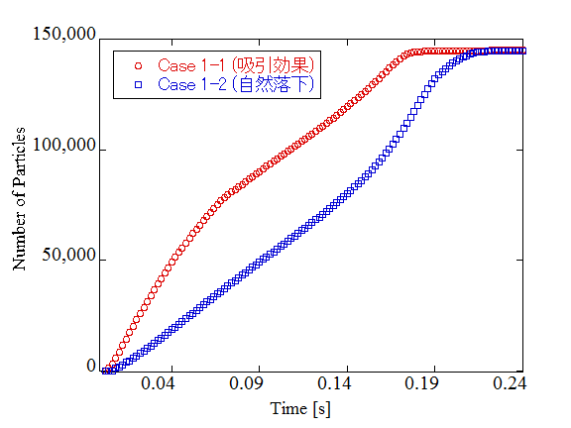
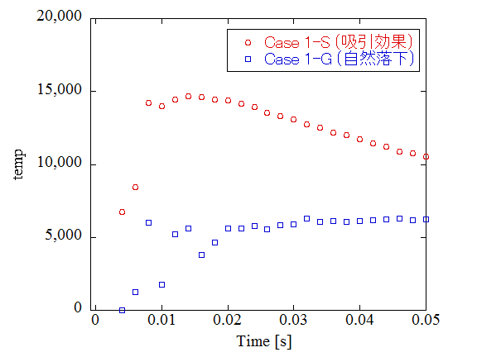
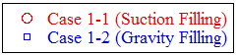
Results & Discussion (Quantitative Evaluation)
Flux of Particles [1/s・mm²]
0.174 s
0.210 s
Approx. 83%
The times particles had filled 99% in each case are written.
In case suction, powder filling took 83% time compared with case gravity. The suction effect shortened the powder filling time.
In case suction, the flux of powder flow increased rapidly compared with case gravity. The suction effect accelerated the flux of powder.
The flux increased rapidly and the filling time was shortened
Notes:
9, 10分ぐらいで、このCaseが終了したらいいかんじ。

Slide 10
Influence of the Moving Speed of the Lower Punch

Slide 11
Simulation Conditions
To understand the influence of the moving speed of lower punch in the suction filling, compare 3 cases.
Physical Properties
 | Case 2-1 | Case 2-2 | Case 2-3
Speed of Lower Punch [mm/s] | 100 | 200 | 300
Gas phase
Viscosity | $1.8×{10}^{−5}$ [Pa・s]
Density | 1 [kg/m³]
Solid phase
Density | 1500 [kg/m³]
Spring constant | 50 [N/m]
Coefficient of restitution | 0.9
Coefficient of friction | 0.3
Calculation Conditions
Diameter | 250 [μm]
Number of particles | 500,000
System | Mono-dispersed
Grid size | 0.5 [mm]
Calculation time | 0.24 [s]
Punch
Unit : mm
Schematic Geometry
Initial Position of Particles

Slide 12
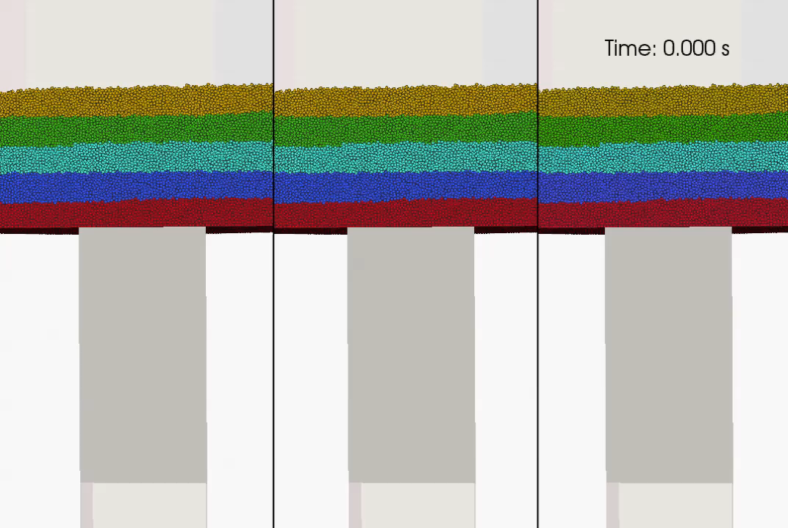
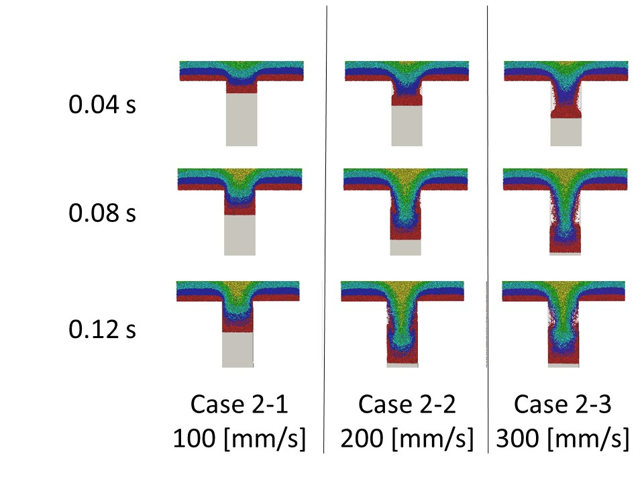
Results & Discussion (Effect of punch movement)
Case 2-1
100 mm/s
Case 2-2
200 mm/s
Case 2-3
300 mm/s
Case 2-1
100 mm/s
Case 2-2
200 mm/s
Case 2-3
300 mm/s
Powder had followed to the punch in each speed

Slide 13
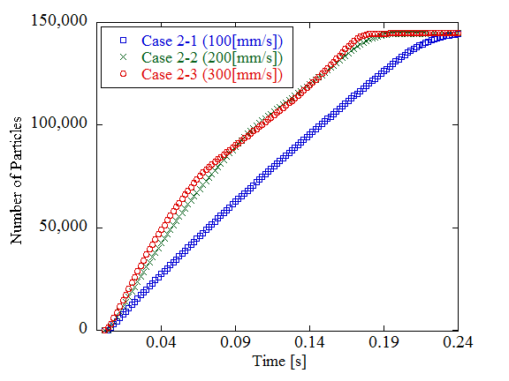
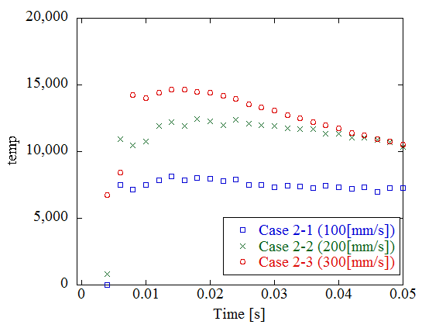
Results & Discussion (Quantitative Evaluation)
0.174 s
Flux of Particles [1/s・mm²]
0.186 s
0.228 s
Approx. 76%
Approx. 82%
The times particles had filled 99% in each case are written.
In case 200 and 300 mm/s, powder filling took 82% and 76% time respectively compared with case 100 mm/s. As the punch speed was higher, the filling time was shorter.
As the punch speed was higher, the flux increased rapidly. It is quantitatively suggested that higher punch velocity accelerated the flux of powder flow.
originality
Higher punch speed accelerated the flux and shorten the filling time

Slide 14
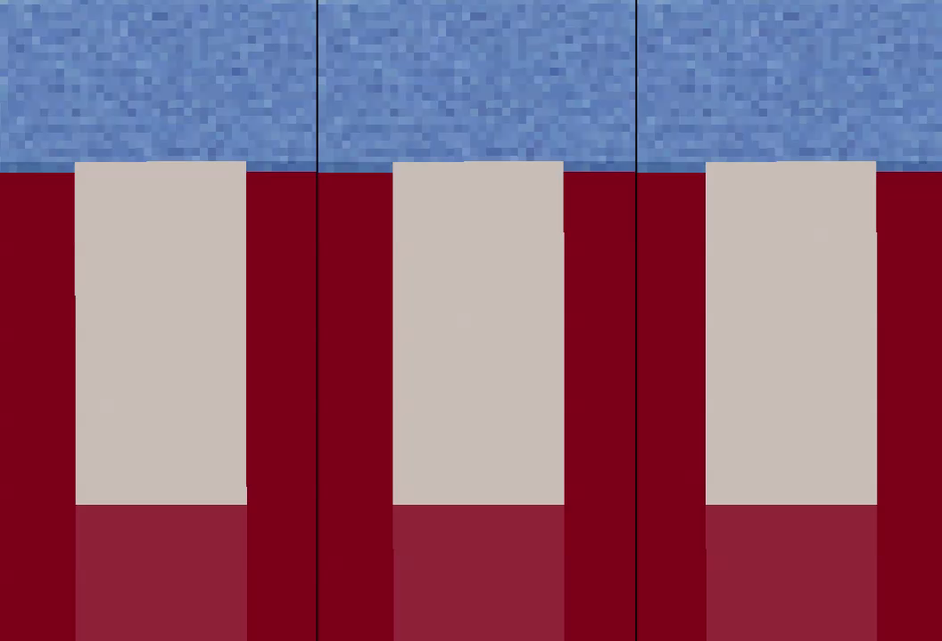
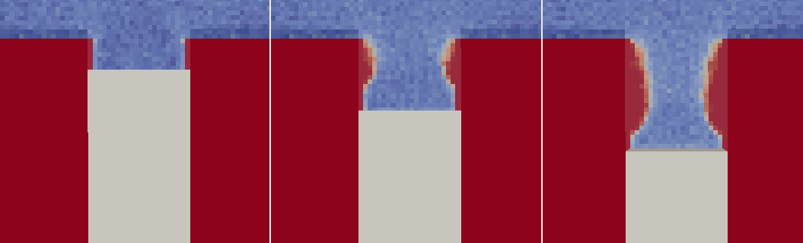
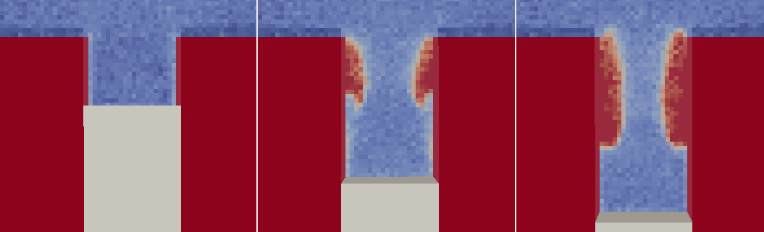
Results & Discussion (Void Fraction)
0.040s
0.080s
Case 2-1
100 mm/s
Case 2-2
200 mm/s
Case 2-3
300 mm/s
Case 2-2
200 mm/s
Case 2-3
300 mm/s
Rising bubble prevented the flux of powder flow

Slide 15
Conclusions
1. How does the suction effect influences the powder?
originality
Air pressure gradient influenced to the powder only at the moment of the punch started moving down.
The pressure gradient occurred above the punch moving down. It suctions powder onto the punch and made the path of powder which had accelerated the flux of powder flow.
2. Influence of the moving speed of lower punch for the filling time
originality
As the moving speed of lower punch was higher, the filling time was shorter.
Higher punch velocity accelerate the influx of powder and shorten the filling time. After punch had finished moving down, bubble started rising and prevented the flux of powder flow.
Notes:
12分

Slide 16
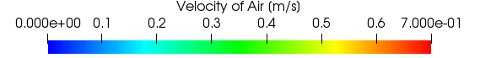
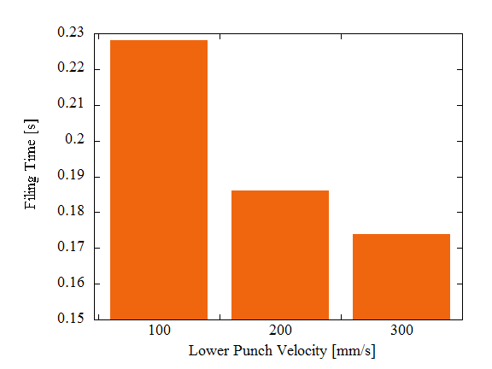
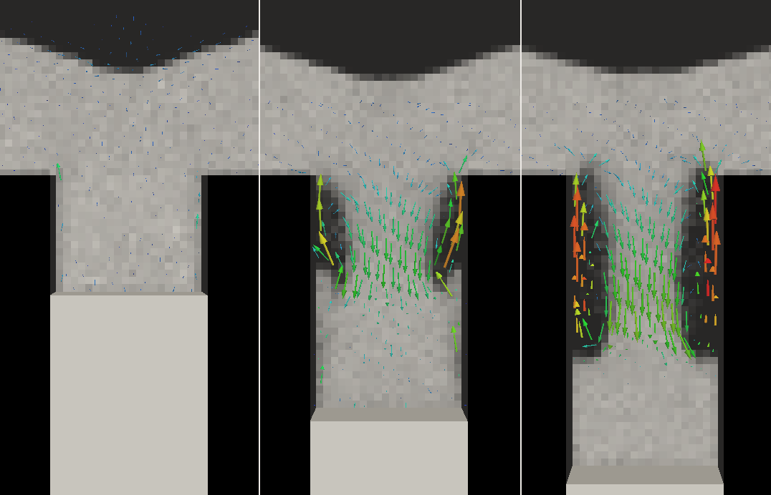
Results & Discussion
0.042s
0.012s
Case 2-1
100 [mm/s]
Case 2-2
200 [mm/s]
Case 2-3
300 [mm/s]
Vector of air flow (0.08 [s])
The time shortened by the increase of velocity had gradually decreased. It shows that something prevented the influx of powder.
As the punch velocity is higher, the vortex in the die became larger. And it looked like limiting the path of the powder flux.
originality
Higher punch velocity made the larger vortex
Notes:
11分

Slide 17
Conclusions
1. How does the suction effect affect the powder
originality
Air pressure gradient affects to the powder only at the moment of the punch start lowering.
The pressure gradient occurs above the punch when it start lowering. It suctions powder onto the punch and make the path of powder which has accelerate the influx of powder.
2. Influence of the lower punch velocity for the filling time
originality
As the punch velocity is higher, the filling time is shorter, but the effect gradually decreases.
Higher punch velocity accelerate the influx of powder. But it creates the larger spiral flow which makes path of the powder narrow. It is suggested that this is one of the reason that the suction effect for filling time gradually decreases as punch velocity is higher.
Notes:
12分

Slide 18
Discussion (Results & Discussion)
Case 2-1
100 [mm/s]
Case 2-2
200 [mm/s]
Case 2-3
300 [mm/s]
Case 2-2
200 [mm/s]
Case 2-3
300 [mm/s]
As the punch velocity is higher, the spiral flow in the die became larger. And it looked like limiting the path of the powder flux.
Vector of air flow
(when overlapping started)
originality
Higher punch velocity creates the larger spiral flow
Notes:
11分

Slide 19
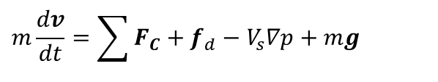
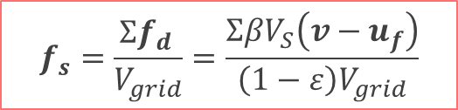
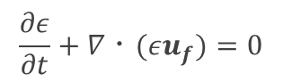
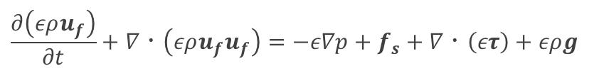
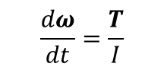
Numerical Method
・Modeling of solid phase and gas phase
In this study, for modeling solid-gas phase interaction DEM-CFD method^{[1]} (Discrete Element Method - Computational Fluid Dynamics) was used. (Particles are modeled by DEM, Air is modeled by CFD)
Solid Phase : DEM^{[2]}
$$m\frac{dv}{dt}=\sum{F_{C}}+f_{d}−V_{s}∇p+mg$$
$$f_{s}=\frac{Σf_{d }}{V_{grid}}=\frac{ΣβV_{S}\left(v−u_{f}\right)}{\left(1−ε\right)V_{grid}}$$
$$\frac{dω}{dt}=\frac{T}{I}$$
+
Exchange of momentum
Gas Phase : CFD + Local Average Volume^{3]}
$$\frac{∂\left(ερu_{f}\right)}{∂t}+∇・\left(ερu_{f}u_{f}\right)=−ε∇p+f_{s}+∇・\left(ετ\right)+ερg$$
$$\frac{∂ε}{∂t}+∇・(εu_{f})=0$$
[1] Y. Tsuji et al., Powder Tec. (1993).
[2] P.A. Cundall and O.D. Strack, Geotechnique (1979)
[3] T.B. Anderson and R. Jackson, Ind. Eng. Chem. Fundam. (1967)

Slide 20
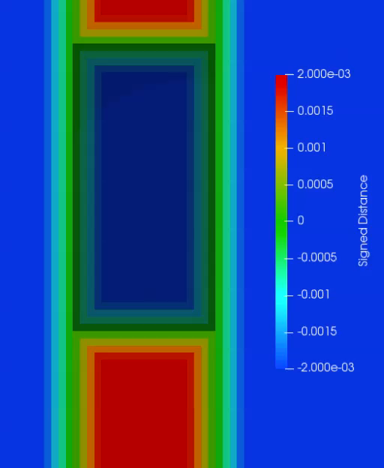
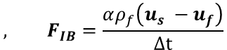
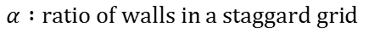
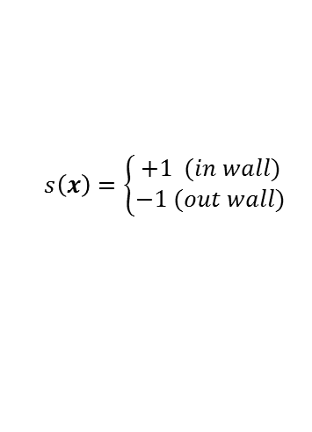
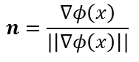
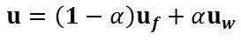
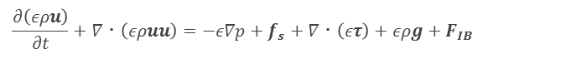


Numerical Method
・Boundary Conditions
In this study, we used Signed Distance Function^{[2]} and Immersed Boundary Method^{[3]} combinedly to calculate moving boundary in gas-solid flow. This combination of boundary conditions had verified.^{[4][5]}
Solid Phase : SDF^{[1]}
$$φ\left(x\right)=d\left(x\right)⋅s\left(x\right)$$
$$n=\frac{∇φ\left(x\right)}{|\left|∇φ\left(x\right)\right||}$$
$$s\left(x\right)=\left\{\begin{aligned}+1 (in wall) \\ −1 (out wall)\end{aligned}\right.$$
+
Gas Phase : IBM^{[2]}
$$u=\left(1−α\right)u_{f}+αu_{w}$$
$$, F_{IB}=\frac{αρ_{f}\left(u_{s} −u_{f}\right)}{Δt}$$
$$\frac{∂\left(ερu\right)}{∂t}+∇・\left(ερuu\right)=−ε∇p+f_{s}+∇・\left(ετ\right)+ερg+F_{IB}$$
$$α :ratio of walls in a staggard grid$$
$$u_{f} :wall velocity, u_{f} :fluid velocity$$
Signed Distance is changing with wall moving
[1] Y. Shigeto et al, Chem. Eng. J. (2013).
[2] C.S. Peskin, J. Comput. Phys. (1972).

